Slide 1
Introduction to Text Mining
08/11/2022
Eléonore Charles

Slide 2


Slide 3
Introduction
Introduction to regular expressions
Introduction to spaCy
Text vectorization
Sentiment analysis modeling
L’Oréal case: custom NER model using prodigy and spacy

Slide 4


Slide 5
Introduction
Some definitions

Slide 6
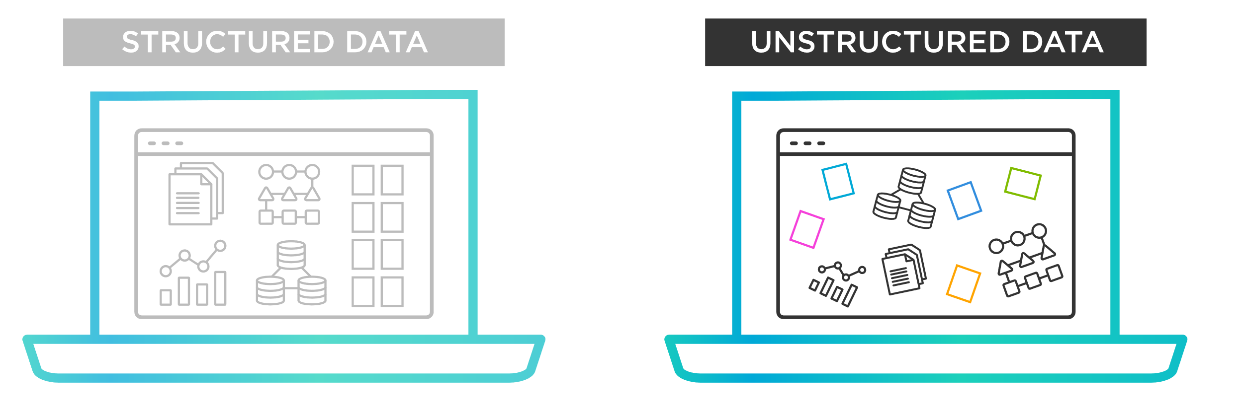
Importance of NLP
Businesses are overwhelmed with unstructured data…

Slide 7
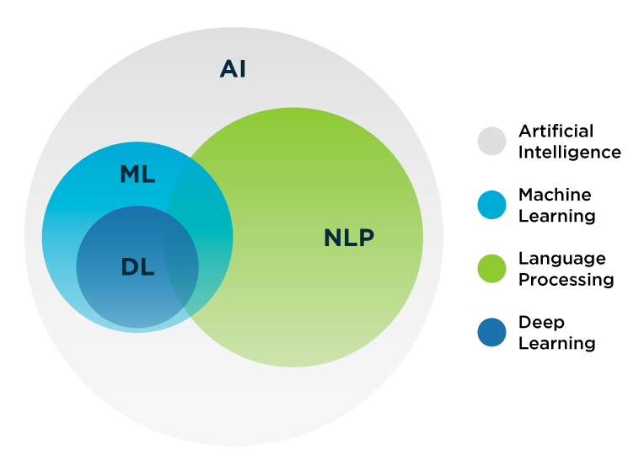
Natural Language Processing (NLP)
Subset of AI in which computers can analyze and interpret human language in an efficient and useful way. It is a way to get a human-level understanding of the language for machines.
The earliest NLP applications were rule-based systems that only performed certain tasks. We then moved towards more complex and powerful NLP solutions based on ML and deep learning techniques.

Slide 8
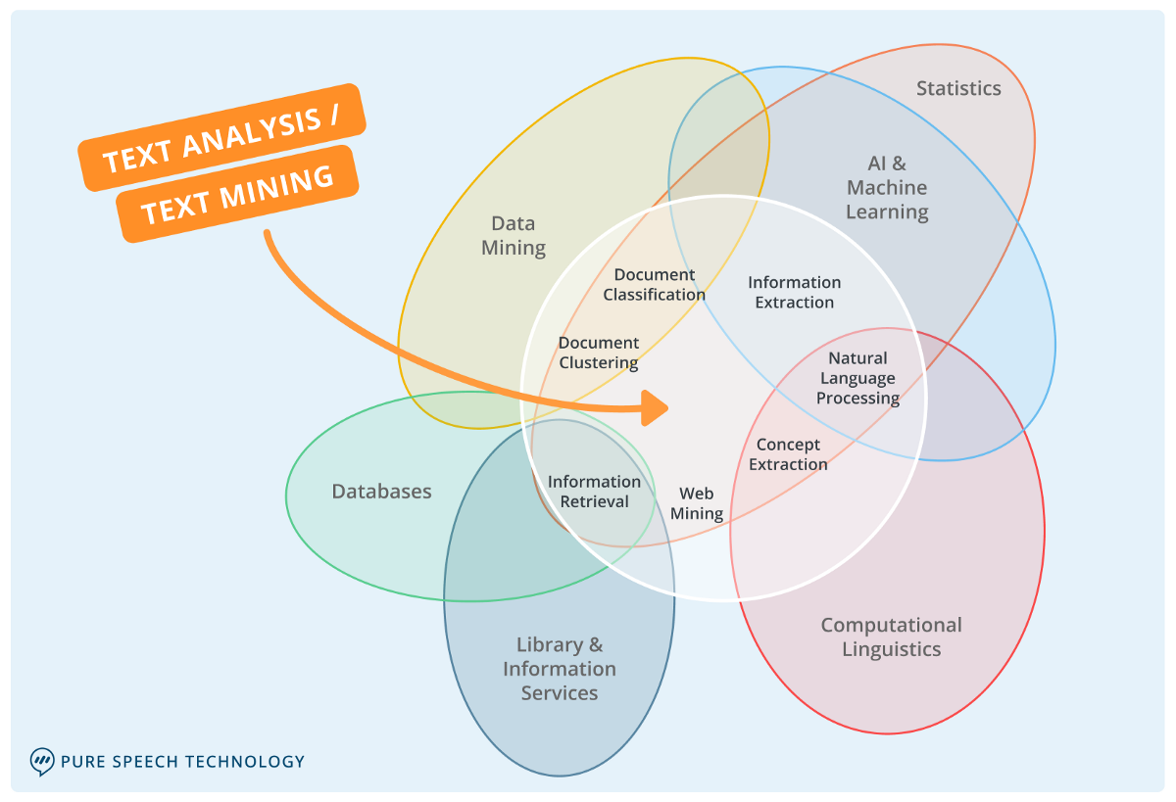
Text mining
Text mining is used to extract information from unstructured and structured content. It focuses on structure rather than the meaning of the content.

Slide 9
Introduction
NLP Use cases

Slide 10
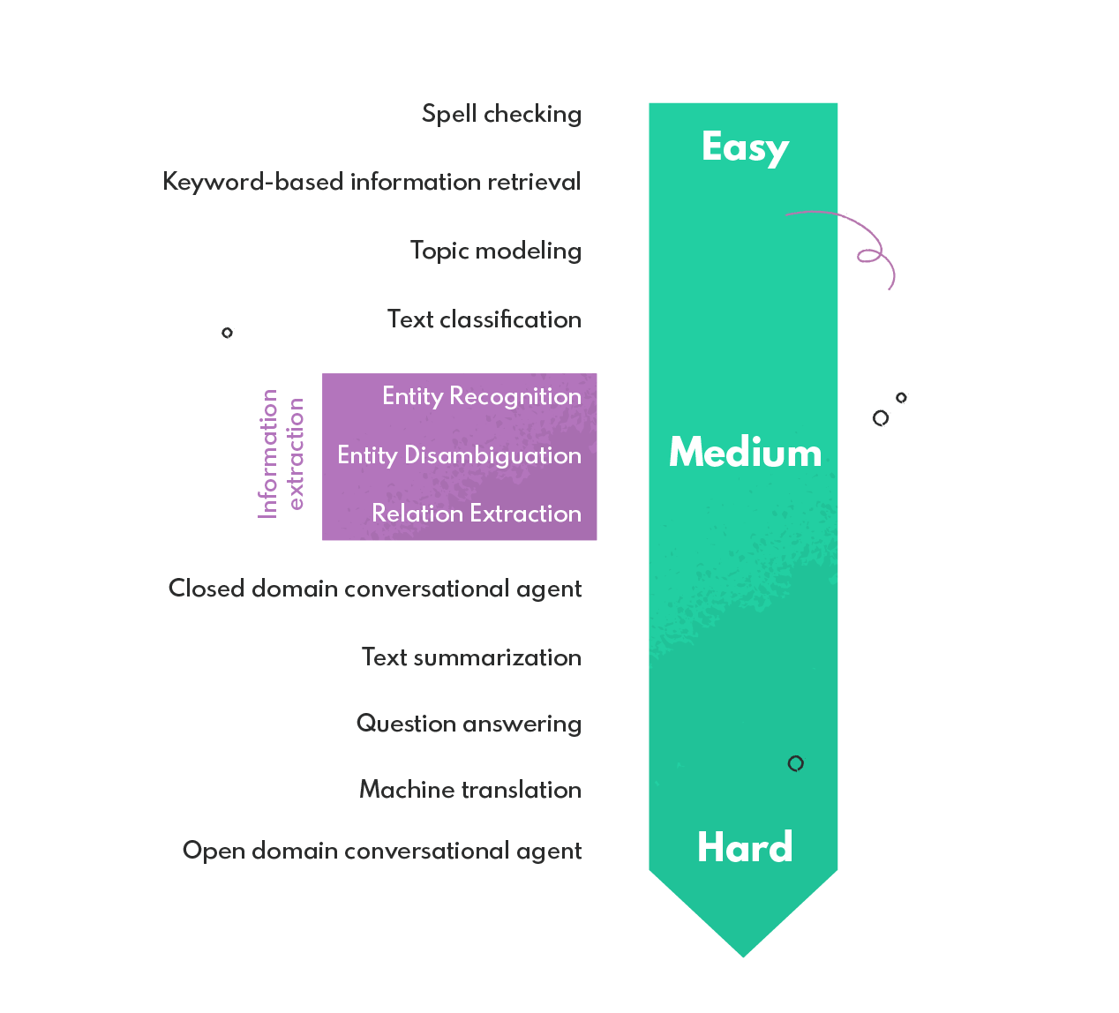
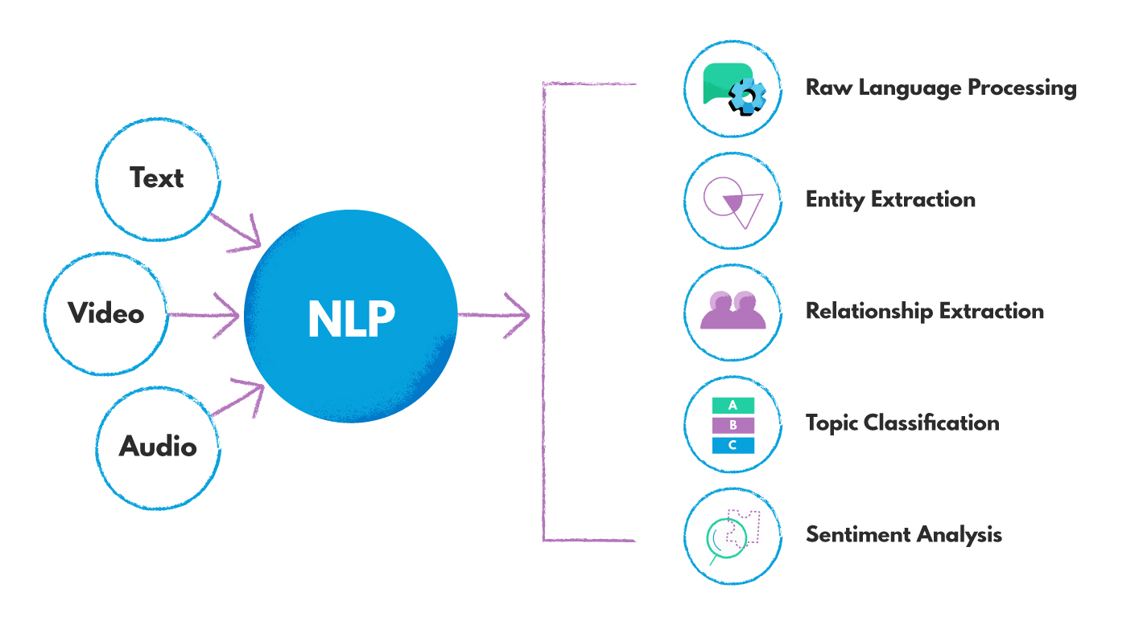
NLP use cases examples

Slide 11
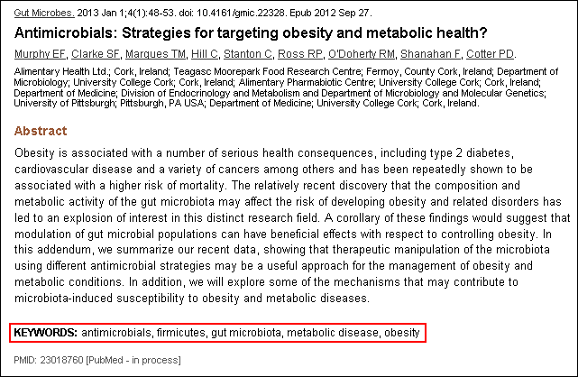
Keyword extraction
Aims to identify all the keywords from a given natural language input.
Services like PubMed auto-tag their articles based on AI keyword extraction.

Slide 12

Text classification
It involves assigning a class to an arbitrary piece of natural language input such as documents, email messages, or tweets.
Text classification has many applications, from spam filtering (e.g., spam, not spam) to the analysis of electronic health records (classifying different medical conditions).
Deep learning methods prove very good at text classification.

Slide 13
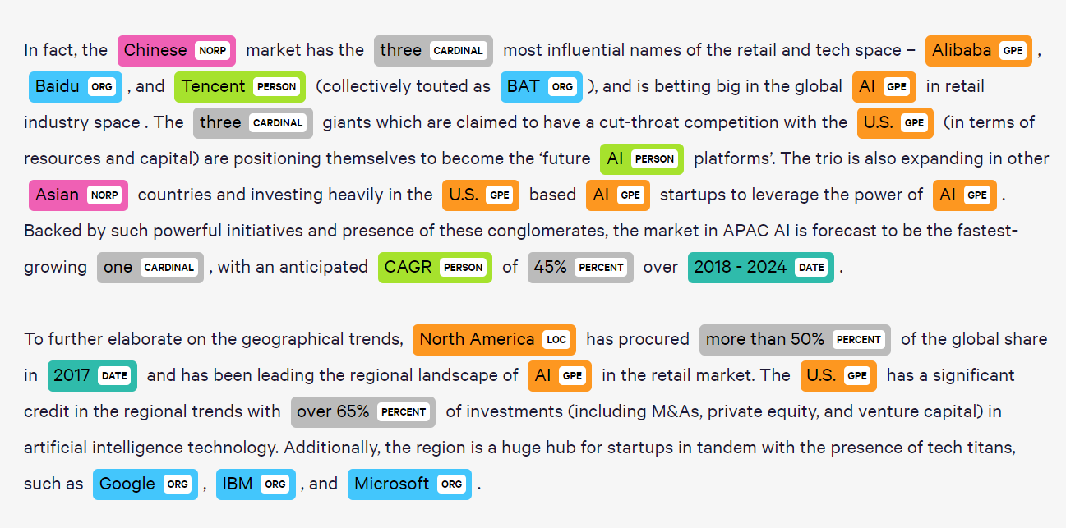
Named Entity Recognition
The entity recognition task involves detecting mentions of specific types of information in natural language input.
Typical entities of interest for entity recognition include people, organizations, locations, events, and products.

Slide 14
Introduction
NLP challenges

Slide 15
Introduction
Python packages

Slide 16
Introduction to regular expressions
Theory

Slide 17
Introduction to regular expressions
Examples

Slide 18
Introduction to regular expressions
Useful tools

Slide 19
Introduction to regular expressions
EXercises

Slide 20
Introduction to spaCy
nlp object

Slide 21
Introduction to spaCy
Documents, spans and tokens

Slide 22
Introduction to spaCy
Lexical attributes

Slide 23
Introduction to spaCy
Stemming

Slide 24
Introduction to spaCy
Statistical models

Slide 25
Introduction to spaCy
Lemmatization

Slide 26
Introduction to spaCy
Sentence segmentation

Slide 27
Introduction to spaCy
Part of speech tagging

Slide 28
Introduction to spaCy
Syntactic dependencies

Slide 29
Introduction to spaCy
Named entities recognition

Slide 30
Introduction to spaCy
Stop words

Slide 31
Introduction to spaCy
Exercises

Slide 32
Text vectorization
Bag of words

Slide 33
Text vectorization
Tf-idf

Slide 34
Text vectorization
Word embeddings

Slide 35
Sentiment analysis modeling
Sample submission

Slide 36
Sentiment analysis modeling
Your turn!

Slide 37
L'Oreal case: custom NER model using prodigy and spacy
???

